Slide 1
Summer Webinar Series Week 1: Customers with Brain Injuries

Slide 2
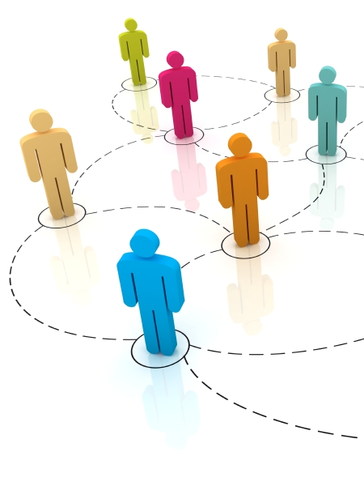
Welcome & Introductions
Olivia White, OTR/L Resource Occupational Therapist MedStar National Rehabilitation Hospital
Nathan Graeff, CTRS Regional Manager, Travel Training MTM, Inc.

Slide 3
What is a Brain Injury?
Traumatic Brain Injury (TBI)
Caused by an external force
Occurs after birth
Types of TBI
Concussion
Contusion
Diffuse axonal injury
Coup-contrecoup injury
Penetrating injury

Slide 4
What is a Brain Injury?
Acquired Brain Injury (ABI)
Injury to the brain which is not hereditary, congenital, degenerative, or induced by birth trauma
Occurs after birth
Types of ABI
Anoxic brain injury
Hypoxic brain injury
Viral or bacterial infection
CVA (Stroke)
Ischemic (clots)
Hemorrhagic (bleeds)
TIA (Transient Ischemic Attack)

Slide 5
Annual Incidences of TBI & ABI

Slide 6
Leading Annual Causes of ABI

Slide 7
Leading Annual Causes of TBI

Slide 8
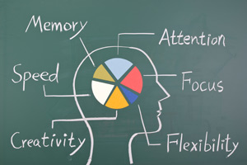
Possible Deficits – Cognitive
Difficulty processing information, expressing thoughts, or understanding others
Shortened attention span
Inability to understand abstract concepts
Impaired decision making ability
Difficulty orienting self to date, time, place, etc.

Slide 9
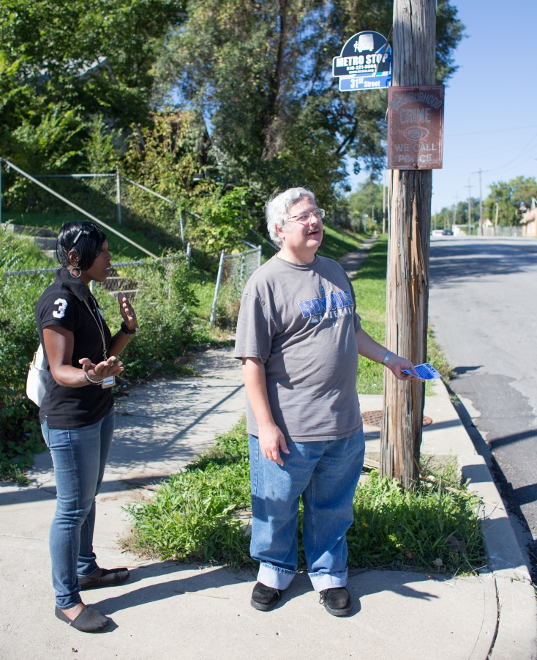
Possible Deficits– Perceptual
Change in hearing or sense of touch
Change in smell & taste
Change in vision
Spatial disorientation
Heightened sensitivity to pain

Slide 10
Possible Deficits– Physical
Persistent headaches
Extreme mental or physical fatigue
Tremors or seizures
Weakness in extremities
Sensitivity to light
Sleep disorders
Slurred speech
Difficulty with balance

Slide 11
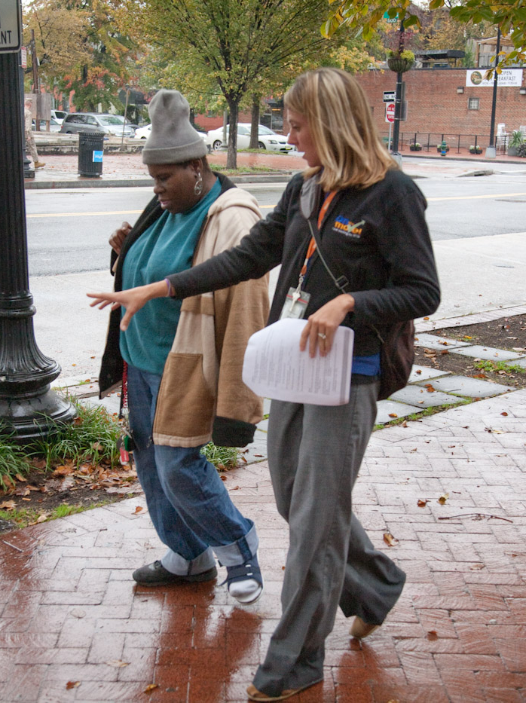
Possible Deficits– Behavioral
Irritability & impatience
Reduced tolerance for stress
Sluggishness
Flattened or heightened emotions or reactions
Denial of disability
Increased aggressiveness

Slide 12
Question 1
When working with an individual with a brain injury, what is the proper terminology to remain respectful?

Slide 13
Question 2
What are physical or perceived barriers to an individual with a brain injury within the community setting? On public transportation?

Slide 14
Question 3
What are some tips, tricks, or tools you find helpful when working with an individual with a brain injury within the community setting? On public transportation?

Slide 15
Question 4
What are some safety concerns to be aware of when working with an individual with a brain injury within the community setting? On public transportation?

Slide 16
Question 5
Do you have a specific example of a situation involving a customer with a brain injury that did not go as expected? How did you handle the situation? What would you do differently or suggest others do instead?

Slide 17
Contact Information
Olivia White, OTR/L Resource Occupational Therapist MedStar National Rehabilitation Hospital olivia.g.white@medstar.net
Nathan Graeff, CTRS Regional Manager, Travel Training MTM, Inc. ngraeff@mtm-inc.net

Slide 18
Questions?

